Slide 1
Classification-Based Destination Recommendation System
Group: F Priyanka Patil
Pranjali Telavane
Gauravkumar Pawar
Sharmili Nag
Agrim Sachdev

Slide 2
Overview
The whole and sole purpose of the system is to provide destination recommendations to the users as per his/her mood or interest.

Slide 3
Data Set :
Dataset source: https://archive.org/details/201309_foursquare_dataset_umn
Initial Foursquare dataset contained 227,428 check-ins from 1,083 users in the New York City area. Each of these check-in rows contained information about the user’s ID, the venue ID, the venue category ID, the venue category name, the location of the venue (latitude and longitude) time of the check-in.

Slide 4
Supporting files with Dataset:
File Name | Details
processed_data_subcategories.txt | List of check-ins for each of the 1083 users in the nine main categories of venues. Used for computing similarity measures
processed_categories_frequency.csv | List of check-ins for each of the 1083 users in the nine main categories of venues. Used for computing clusters for data.
categories.csv | A list of the nine main categories provided by foursquare, used while asking user what category of place he would like to visit.

Slide 5
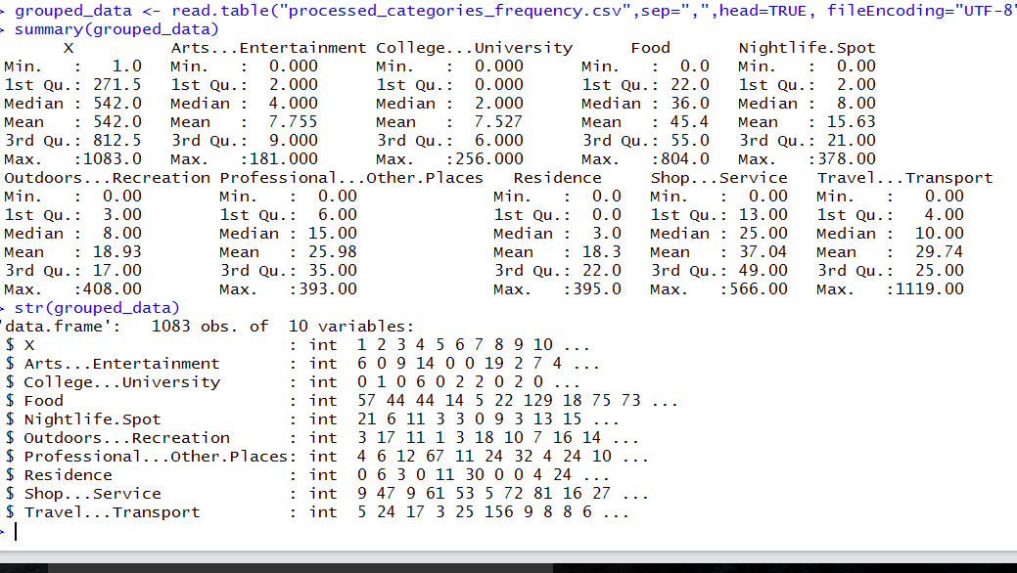
Data Analysis:
Distribution of data across nine main categories

Slide 6
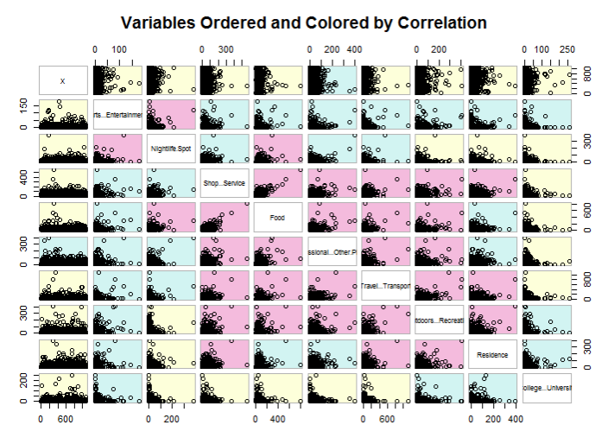
Data Analysis Step 2 :
Scatterplots

Slide 7
Machine Learning Algorithm Used:
K-Means Clustering to divide users in seven clusters based upon their visiting frequency
Decision Tree Classification to assign test user to respective cluster

Slide 8
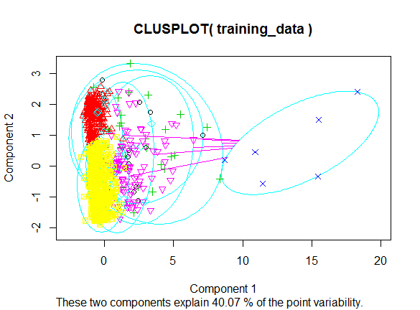
User Clusters :

Slide 9
Cosine Similarity of Top Users
groupedData_subset...1. usersim User
31 372 0.8016920 111
37 443 0.7384163 111
46 492 0.7186708 111
33 390 0.7111000 111
71 699 0.6848015 111
395 664 0.8996019 110
232 325 0.8576855 110
328 502 0.8499531 110
278 402 0.8451077 110
350 554 0.8447299 110
50 525 0.8785941 109
45 508 0.8774934 109
92 661 0.8634505 109
235 971 0.8612571 109
171 843 0.8335300 109

Slide 10
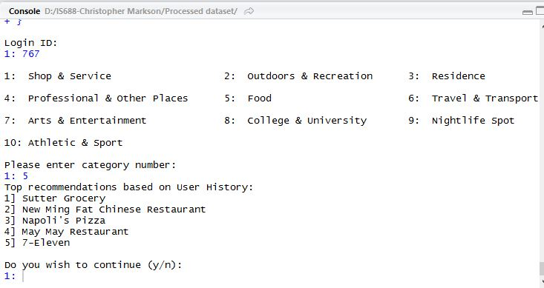
Recommendation:

Slide 11
Conclusion:
Recommender systems provide users with personalized content and services by filtering, prioritizing and efficiently delivering relevant information in order to alleviate the problem of information overload.
In spite of significant progress in the research community, and industry efforts to bring the benefits of new techniques to end-users, there are still important gaps that make personalization and adaptation difficult for users.
Here, a recommendation system has been implemented based on clustering and classification for helping users discover new places of interest in different categories based on similar users’ habits. We are essentially predicting the user’s likeability of a place the user has never visited.

Slide 12
References
Data Mining Introductory and Advanced Topics, Margaret H. Dunham
Clustering Algorithm
https://web.stanford.edu/class/cs345a/slides/12-clustering.pdf
Decision Tree Algorithm
https://en.wikipedia.org/wiki/Decision_tree_learning
Recommendation Systems
http://infolab.stanford.edu/~ullman/mmds/ch9.pdf

